Slide 1
THIRUNIRAISELVI M
Final Project
3/21/2024 Annual Review

Slide 2
PROJECT TITLE
Classification of Brain Tumors
3/21/2024 Annual Review

Slide 3


AGENDA
Problem Statement
Project Overview
Who are the end users?
Solutions and value of propositions
WOW factor in the solution
Modelling
Results
3/21/2024 Annual Review

Slide 4

PROBLEM STATEMENT
Brain tumors present a complex and challenging landscape in the field of neurology and oncology. Among the myriad of brain tumors, three prevalent types stand out: Glioma, Meningioma, and Pituitary Tumors. However, a comprehensive comparative analysis of these tumors is essential to understand their nuances fully and develop tailored strategies for diagnosis, treatment, and management. A brain tumor is a collection, or mass, of abnormal cells in your brain. Your skull, which encloses your brain, is very rigid. Any growth inside such a restricted space can cause problems. Brain tumors can be cancerous (malignant) or noncancerous (benign). When benign or malignant tumors grow, they can cause the pressure inside your skull to increase. This can cause brain damage, and it can be life-threatening.
3/21/2024 Annual Review

Slide 5

PROJECT OVERVIEW
The objective of the Brain Tumor Classification Challenge is to develop and validate a robust deep learning model capable of accurately classifying brain tumors into their respective categories. The primary goal is to
Train a model using a diverse dataset of brain tumor images to accurately classify each tumor into its appropriate category
Enable the model to differentiate between multiple tumor types present in a single image
Develop strategies to effectively deal with rare tumor types or subtypes that may have limited representation in the dataset
Integrate domain expertise from neurologists, oncologists, and radiologists to inform the model development process, guiding feature selection, annotation, and interpretation of imaging data to enhance classification accuracy.
Create a robust machine learning solution for accurately categorizing brain tumors.
3/21/2024 Annual Review

Slide 6

WHO ARE THE END USERS?
The end users for the classification of brain tumors would primarily be healthcare professionals specializing in neurology, oncology, and radiology, as well as medical researchers and policymakers. Here are some reasons why these end users would find the classification model valuable:
Precise Treatment Planning
Efficient Resource Allocation
Enhanced Clinical Decision-Making
Research and Development
Patient Empowerment
3/21/2024 Annual Review

Slide 7

YOUR SOLUTION AND ITS VALUE PROPOSITION
My solution for addressing the challenges of accurate diagnosis in brain tumors is a sophisticated deep learning model tailored specifically for neuro-oncology. By leveraging a diverse dataset of medical imaging scans, including MRI and CT scans, our model has been meticulously trained to classify brain tumors with high precision and reliability.
The value propositions are:
Accurate Diagnosis
Early Detection and Intervention
Facilitated Research and Development
Accelerated Research and Innovation
Efficient Clinical Workflow
3/21/2024 Annual Review

Slide 8

THE WOW IN YOUR SOLUTION
The wow factor in our brain tumor classification solution lies in its unprecedented precision and adaptability, revolutionizing neuro-oncology diagnosis and treatment. Through advanced machine learning techniques and extensive training, our model accurately classifies tumors into categories such as Glioma, Meningioma, and Pituitary Tumors. Its comprehensive understanding, adaptability to complex scenarios, and seamless integration into clinical workflows empower healthcare professionals with precise diagnoses and tailored treatment plans, ultimately improving patient outcomes and workflow efficiency.
3/21/2024 Annual Review

Slide 9
MODELLING
The process begins with data preprocessing, splitting the dataset into training and validation sets, followed by defining data loaders. The custom CNN model, BrainTumorCNN, comprising convolutional and fully connected layers, is then trained using the Adam optimizer and cross-entropy loss function. The training loop iterates over epochs, optimizing model parameters while evaluating performance on the validation data. Post-training, the model's accuracy is assessed using a validation set, and a confusion matrix visualizes classification performance across tumor types. Additionally, the code integrates data preprocessing steps, PyTorch framework for efficient model training, tqdm for progress visualization, and accuracy metrics calculation, contributing to a comprehensive approach in brain tumor classification, aiding in disease diagnosis and patient care in neuro-oncology
3/21/2024 Annual Review

Slide 10
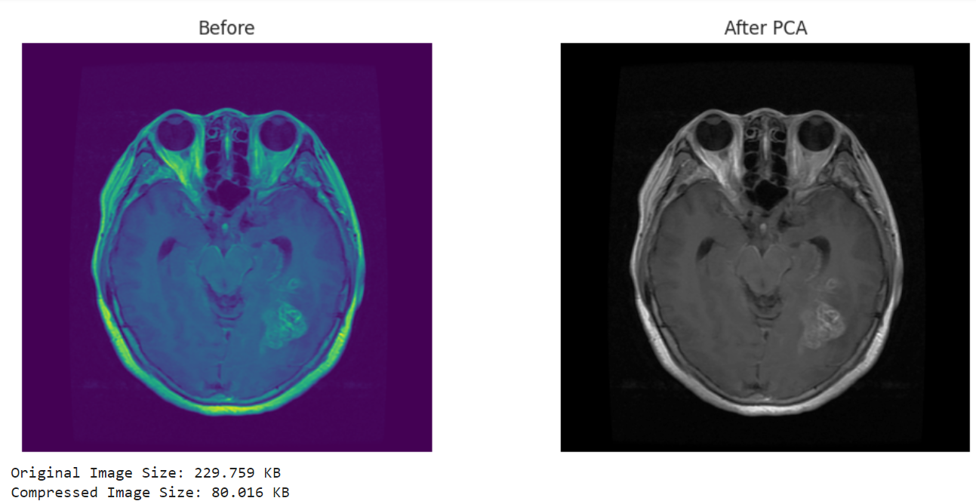
RESULTS
3/21/2024 Annual Review

